Slide 1
.
Natural Resources: Introduction, Classification.
Water Resources; Availability, sources and Quality Aspects, Water Borne and Water Induced Diseases, Fluoride and Arsenic Problems in Drinking Water.
Mineral Resources; Material Cycles; Carbon, Nitrogen and Sulfur cycles.
Energy Resources; Conventional and Non conventional Sources of Energy.
Forest Resources; Availability, Depletion of Forests, Environment impact of
forest depletion on society.

Slide 2
UNIT 2
Natural Resources
Natural resources occur naturally within environments that exist relatively undisturbed by humanity, in a natural form.
Natural resources are derived from the environment.
Some of them are essential for our survival, while most are used for satisfying our wants.
•

Slide 3
Conserving Natural Resources
Resources are features of environment that are important and value of to human in one form or the other. However, the advancement of modern civilization has had a great impact on our planet's natural resources.
So, conserving natural resources is very essential today. There are many ways that one can conserve natural resources.

Slide 4
Conserving Natural Resources
All we need to do is to look around and see what natural resources we are using and find out ways to limit their usage.
4’R’ principle is quite significant in the conservation of natural resources- ie Refuse (avoid or say NO), Reduce (no wastage), Reuse and Recycle. This may/should be applied to all types of resources.

Slide 5
Classification of Natural Resources
Renewable Resources – Renewable resources can be replenished naturally. Some of these resources, like sunlight, air, wind, etc., are continuously available and their quantity is not noticeably affected by human consumption.
Though many renewable resources do not have such a rapid recovery rate, these resources are susceptible to depletion by over-use.
Resources from a human use perspective are classified as renewable only so long as the rate of replenishment/recovery exceeds that of the rate of consumption.

Slide 6
Non-Renewable Resources
Non-renewable resources either form slowly or do not naturally form in the environment. Minerals are the most common resource included in this category.
By the human perspective, resources are non-renewable when their rate of consumption exceeds the rate of replenishment/recovery; a good example of this are fossil fuels, which are in this category because their rate of formation is extremely slow (potentially millions of years), meaning they are considered non-renewable.

Slide 7
Non-Renewable Resources
Some resources actually naturally deplete in amount without human interference, the most notable of these being radio-active elements such as uranium, which naturally decay into heavy metals. Of these, the metallic minerals can be re-used by recycling them, but coal and petroleum cannot be recycled.

Slide 8
Resources can be grouped as-
Water Resources
Mineral Resources
Forest Resources
Food Resources
Energy Resources

Slide 9
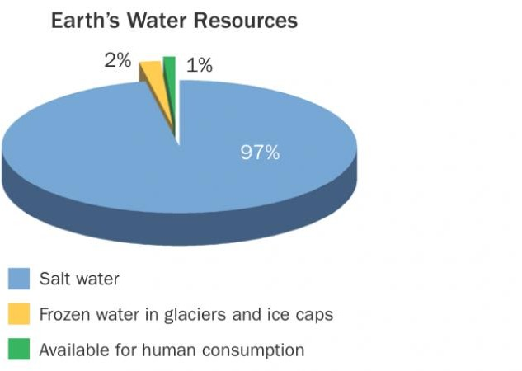
Water Resources

Slide 10
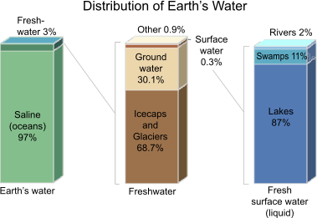

Slide 11
Conservation of Water
Conservation and management of water are essential for the survival of mankind, plants and animals. Water resources are sources of water that are useful or potentially useful.
Uses of water include –
Agricultural
Industrial
Household
Recreational
Environmental Activities

Slide 12
Conservation of Water
The majority of human uses require freshwater. 97 percent of the water on the Earth is salt water and only three percent is fresh water; slightly over two thirds of this is frozen in glaciers and polar ice caps.
The remaining unfrozen fresh water is found mainly as groundwater, with only a small fraction present above ground or in the air.

Slide 13
Conservation of Water
Fresh water is a renewable resource. The framework for allocating water resources to water users (where such a framework exists) is known as water rights. This can be achieved adopting the following methods:

Slide 14
Growing vegetation in the catchment areas, which
will hold water in the soil and allow it to percolate
into deeper layers and contribute to formation of
ground water.
Constructing dams and reservoirs to regulate
supply of water to the fields, as well as to enable
generating hydroelectricity.
Sewage should be treated and only the clear water
should be released into the rivers.
Industrial wastes (effluents) should be treated to
prevent chemical and thermal pollution of fresh
water.
Judicious use of water in our day-to-day life.
Rainwater harvesting should be done by storing
rainwater and recharging groundwater.
Recycling of waste water.
Desalinization of salty water.
Irrigation process should be improved and less
water should be wasted.

Slide 15
The main reasons for the degradation of water are:
To meet the need of increasing population,
surface water (water from ponds, lakes,
rivers, etc) and ground water are
overdrawn.
2.Sewage i.e., waste water from domestic
and municipal use makes fresh water unfit
for use by human beings and animals.
Waste water, from all industries flow
down the surface water bodies and ground
Water bodies and they get polluted.

Slide 16
CONFLICTS OVER WATER
Kaveri River water dispute
The sharing of waters of the Kaveri has been the source of a serious conflict between the Indian states of Karnataka and Tamil Nadu. The state of Karnataka contends that it does not receive its due share of water from the river as Tamil Nadu does. Decades of negotiations between the parties bore no fruit.
Godavari Water Disputes Tribunal
Godavari river basin is spread in the states of Maharashtra, Orissa, old Madhya Pradesh {later bifurcated into present Madhya Pradesh (MP) and Chhattisgarh), Karnataka (K) and Andhra Pradesh (AP).

Slide 17
CONFLICTS OVER WATER
Godavari Water Disputes Tribunal
Godavari river basin is spread in the states of Maharashtra, Orissa, old Madhya Pradesh {later bifurcated into present Madhya Pradesh (MP) and Chhattisgarh), Karnataka (K) and Andhra Pradesh (AP).

Slide 18
International water dispute
The most likely sources of inter-state water conflict are the Nile drainage basin, the Tigris- Euphrates River and the Jordan River. All of these potential sites of conflict involve several countries. The conflicting water-diversion projects by Israel and Syria were a significant
contributor to the 1967 Six Day War.

Slide 19
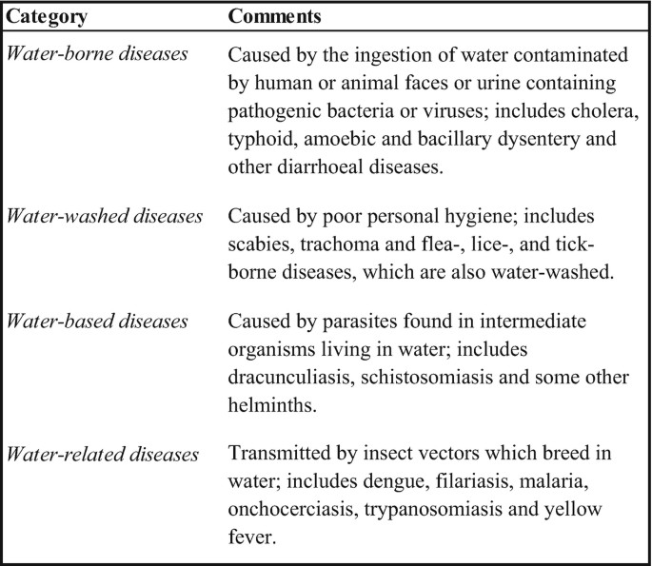
Water Borne and Water Induced Diseases

Slide 20
Definition- Any disease that can spread through contaminated water. The contamination can involve bacterial, viral or protozoan organisms. Some examples of waterborne diseases include cholera (bacteria), dysentery (bacteria or amoeba), cryptosporidiosis (protozoa), hepatitis A (virus) and giardia (protozoa). Infection can result not only from drinking the water but also from swimming in the water where it can enter the body in other ways such as through broken skin. Many poorer countries have limited uncontaminated water supplies so waterborne disease is a huge health issue worldwide.

Slide 21
Fluoride and Arsenic Problems in
Drinking Water
An estimated 300 million people worldwide use drinking water contaminated with arsenic or fluoride.
These trace elements are natural (geogenic) contaminants, leached into groundwater from rocks and sediments.
Depending on the geological conditions, they may occur in concentrations which pose a risk to human health.
The guideline values specified by the World Health Organization are 10 micrograms per liter for arsenic and 1.5 micrograms per litre for fluoride.

Slide 22
Fluoride and Arsenic Problems in
Drinking Water
Elevated concentrations are found in particular in parts of Asia, Africa and South America. The problem thus mainly affects people in developing and emerging countries whose drinking water is obtained from groundwater wells.
In many regions of Asia, Africa and South America, consumption of groundwater contaminated with arsenic or fluoride causes severe health problems.

Slide 23
Fluoride and Arsenic Problems in Drinking Water
Regular use of contaminated water causes serious damage to health. Chronic exposure to arsenic leads to discoloration and thickening of the skin and can also cause cardiovascular disorders or cancer. Excessive fluoride levels are associated with mottling of the teeth and bone and joint deformities.
Various technologies which are suitable for arsenic or fluoride removal in developing countries, including household, community and centralized treatment systems. Arsenic removal generally involves two steps – oxidation and ion exchange. Fluoride can be removed from drinking water by filtration or precipitation.

Slide 24
Arsenic removal from water
1. Small-scale water treatment
A simpler and less expensive form of arsenic removal is known as the Sono arsenic filter, using three pitchers containing cast iron turnings and sand in the first pitcher and wood activated carbon and sand in the second. Plastic buckets can also be used as filter containers.

Slide 25
Arsenic removal from water
Chaff-based filters have been reported to
Reduce the arsenic content of water to 3
microgram/litre.
This is especially important in areas where
the potable water is provided by filtering the
Water extracted from the underground aquifer.

Slide 26
Arsenic removal from water
1. Large-scale water treatment
In some places, such as the United States, all the water supplied to residences by utilities must meet primary (health-based) drinking water standards. Regulations may necessitate large-scale treatment systems to remove arsenic from the water supply.

Slide 27
Coagulation/filtration (also known as flocculation) removes arsenic by coprecipitation and adsorption using iron coagulants. Coagulation/filtration using alum is already used by some utilities to remove suspended solids and may be adjusted to remove arsenic. But the problem of this type of filtration system is that it gets clogged very easily, mostly within two to three months. The toxic arsenic sludge is further disposed of by concrete stabilization.

Slide 28
2. Mineral Resources
A 'Mineral Resource' is a concentration or occurrence of material of intrinsic economic interest in or on the earth's crust in such form, quality and quantity that there are reasonable prospects for eventual economic extraction.
These are the natural resources which cannot be renewed. They are present in the organisms as an organic and inorganic molecule and ions.
The calcium, phosphorous, sodium, chlorine and sulphur are the major minerals in the animals. The minor minerals in the animals are iron, copper, cobalt, zinc, fluorine and selenium.
The minerals in the plants are divided into the macro and micro nutrients. The macro nutrients consist of calcium, magnesium, sulphur and iron.

Slide 29
. The micro nutrients consist of manganese, cobalt, zinc and chlorine.
We have attained such an enormous level of consumption of our mineral wealth that good quality deposits of many elements have already disappeared while many others are in the process of being depleted.
These resources belong to our children and grandchildren as much as they do to us. It is high time now that we should seriously think about conserving them.

Slide 30
Uses of Minerals- Minerals are used for constructing houses, manufacturing machines and automobiles, ornamenting body parts, various defence activities. So various uses are-
Making weapons
Generating electricity
Manufacturing machines
For industries
Overexploitation of mineral resources cause-
Rapid depletion of high-grade mineral deposits
Wastage of mineral wealth
Pollution of environment from mining
Pollution caused by heavy energy requirement of mining industry

Slide 31
Conservation of minerals- Important steps may be taken to make these deposits last longer are:
Economy in use of Mineral
Resources
Making Finished Products Long
Lasting
Re-Use and Re-Cycling of Metals
Use of Cheaper Substitutes
More Efficient Recovery of Materials from Minerals
Search for New Deposits
Protection of existing mineral deposits

Slide 32
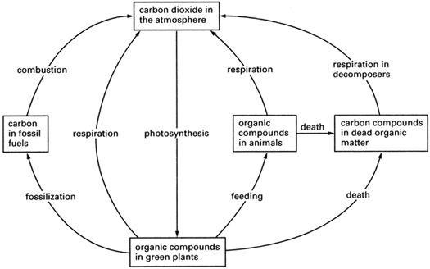
Biogeochemical Cycles / Mineral Flow /
Material Flow in Ecosystem
Carbon Cycle

Slide 33
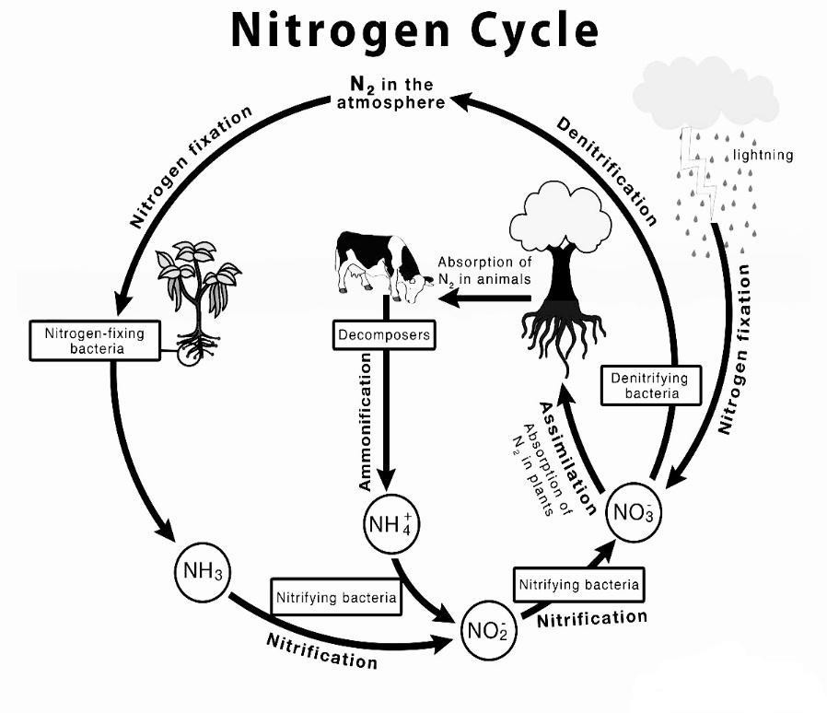

Slide 34
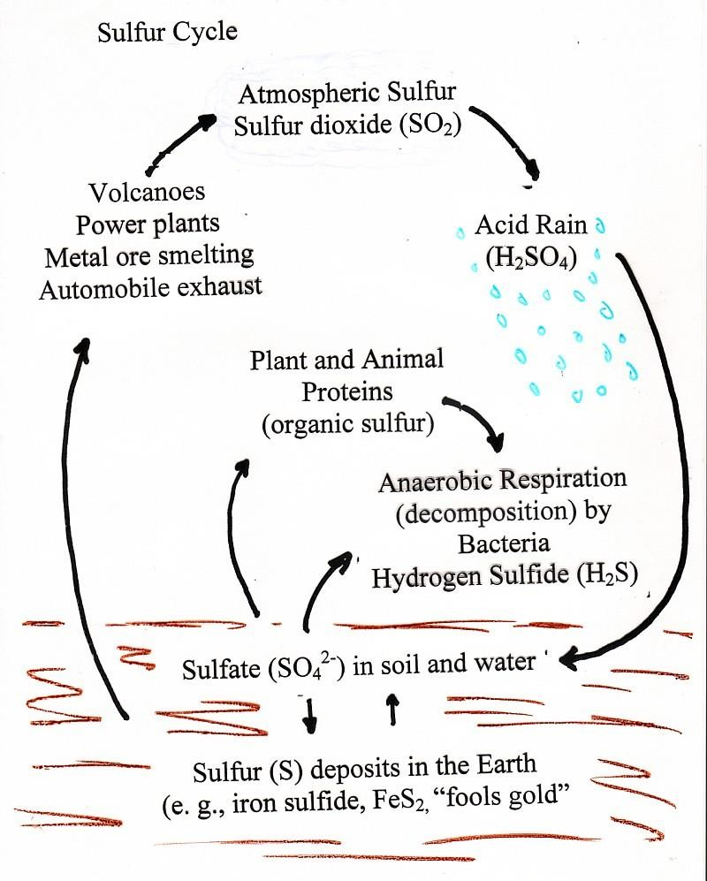
Sulphur Cycle

Slide 35
Energy Resources- Energy resources are, that can be used as a source of energy.
Classification of Energy Resources
On the basis of availability-
(a) Primary energy resources: These are obtained directly from the environment, as:
Fossil fuels such as coal natural gas etc.
Nuclear fuels such as Uranium, Thorium
etc.
Hydro energy
Solar energy
Wind energy
Geothermal energy
Ocean energy such as tidal energy, wave
energy
Biomass energy such as gobar gas
Hydrogen energy

Slide 36
Secondary energy resources: They are
derived from primary energy resources as
they do not exist in nature. The examples
are:
Petrol, diesel, kerosene oil
CNG and LPG
Electrical energy based on coal, diesel
gas

Slide 37
On the basis of being older and newer-
1. Conventional Energy Resources-the examples are:
Fossil fuel
Nuclear energy
Hydro energy
2. Non-conventional Energy Resources-For example includes-
Solar energy
Wind energy
Geothermal energy
Ocean energy
Biomass energy
Hydrogen energy

Slide 38
On the basis of renewable and non-renewable energy resources-
Non-renewable energy resources: The resources which cannot be renewed or recycled are termed as non-renewable energy resources. Excessive use of fossil fuels leads to environmental pollution, out of which CO2 emission is of immense concern.

Slide 39
Renewable energy resources: The resources which can be renewed or recycled are termed as renewable energy resources. These eco-friendly energy resources have the greatest potential to substitute the depleting non-renewable energy resources as alternative sources of energy in the long run. With the environmental conditions becoming worse day by day, people are trying their bit to save the environment by using natural energy resources.
Non-Renewable Energy Resources
Fossil Fuel Based Energy
Fossil fuels are found inside the earth’s crust where they
have formed through heat and compression of forests,
waste and other organic matter, which got buried due to
earthquake, landslide etc. Fossil fuels are of 3 types:
Solid (e.g.-coal),
Liquid (e.g.-petroleum)
Gaseous (e.g.-Natural gas)
a

Slide 40
a)- Coal Energy- Coal is the most abundantly found fossil fuel in the world. It contains carbon, water, sulphur and nitrogen. Coal meets 70% of the total energy needs of the world found and 87.4% of all commercial energy. In India about 58% of commercial energy is obtained from coal and 38% from Petroleum along with natural gas. Coal is used for cooking, heating, in industries and thermal power plants. Petroleum is useful for transportation, agricultural equipments and some industries. Natural gas is used both in cooking and in industries.
b)- Petroleum or Crude Oil - The gaseous fuels are basically derived from petroleum. It is a natural, underground fossil energy resource. It is formed due to decomposition of micro plankton deposited upon the sea beds, lakes and rivers for million of years.

Slide 41
Advantages:
Liquid fuel is easy to transport.
Liquid fuel is comparatively cleaner.
They have made possible the
introduction and development of newer
means of transport.
Disadvantages:
After extraction it causes contamination in the water when the leakage takes place.
Its burning produces CO2 and enhances the
green house effect.
All combustion processes produce the
pollutants like NO, SO2 CO, NO2, CO2
smog, etc.
Petroleum contributes to acid rain
and urban pollution.

Slide 42
c)- Natural Gas.
It is a fossil fuel but does not generate carbon dioxide, which happens to be the chief greenhouse gas.
Thus, natural gas is a better option. It can be created by various organisms, and is also found in areas which have fossil fuels.
After coal and petroleum, natural gas is the third major source of fossil fuel. It contributes to about 24% of the energy requirement of the world.

Slide 43
It is fast emerging as an alternative source as it is eco- friendly in characters.
It is a mixture of hydrocarbon gases trapped beneath the earth’s surface. It is mainly consisting of methane (CHJ, propane (C3H8) and butane (C4H10).
After processing it is transported to supply filling stations. Natural gas can be used in two different forms.
LPG (Liquefied Petroleum Gas).
CNG (Compressed Natural Gas).

Slide 44
Advantages:
It is a clean fuel, requiring little
processing.
It can be readily transported
Smog formation is less in its use
It is eco-friendly and causes less
pollution
Disadvantages:
It requires both high pressure and
low temperature for compression.
Thick-walled tanks are required for
storage as it is stored at a high
pressure.
Methane is a greenhouse gas and has
a large atmospheric lifetime.
Leakage, in any case, is a serious
threat to the environment.

Slide 45
After coal and petroleum, natural gas is the third major source of fossil fuel. It contributes to about 24% of the energy requirement of the world. It is fast emerging as an alternative source as it is eco- friendly in characters. It is a mixture of hydrocarbon gases trapped beneath the earth’s surface. It is mainly consisting of methane (CHJ, propane (C3H8) and butane (C4H10). After processing it is transported to supply filling stations. Natural gas can be used in two different forms.
LPG (Liquefied Petroleum Gas).
CNG (Compressed Natural Gas).

Slide 46
Nuclear Energy. This is created though atoms. Either by merging or splitting atoms, energy is created. Though it produces a large amount of power, it has certain hazards. Nuclear energy can be derived by two methods-nuclear fission and nuclear fusion.
In nuclear fission, the heavy nucleus splits into lighter nuclei with a huge release of energy. But in nuclear fusion two light nuclei of hydrogen fuse to form a helium nucleus with a release of enormous amount of energy. One a.m.u (atomic mass unit) of Uranium-235 yield energy equal to burning of 15 metric tons of coal.
Nuclear reactors are the devices need to liberate energy from nuclear fuels, under controlled conditions. The output of these reactors is in the form of a high temperature fluid. This can be used in the generation of electricity or as a direct source of heat for intensive industries.

Slide 47
Hydro Electric Energy
Hydro power is the cleanest, cheapest &
best source of electricity generation. It
falls under the conventional energy
resource. Energy is derived from fast
flowing water.
Hydropower converts power of the falling
water to electric power which can be
transmitted to long distances through
wires & cables.

Slide 48
Working Principle–
Dammed water is used to generate this
power, which then drives water turbine
and generator. One of the versions of this
is tidal power. The power produce by
water tides generates pressure,
which turns a water wheel or a turbine.
The electrical generator gets energy from
this power.
It can be stored for future use also.
Hydropower is generated by using
hydraulic machine, called turbines.
Now high dams are built to obtain a
substantial amount of hydrostatic
pressure.

Slide 49
II. Renewable energy resources:
1. Solar Energy– The sun rays which is an inexhaustible source of energy which is trapped into solar cells, wherein, it gets transformed into electricity and this is how solar energy is created. It is commonly used for taking salt out of water, and also used for cooking, heating, and of course to produce electricity.
It is utilized by converting it into the following forms:
Thermal Conversion
Photo Conversion
Thermal conversion occurs by direct heating and photo conversion is an indirect conversion.

Slide 50
Utilization /Application of Solar Energy
Solar water heater: Its construction consists of a flat plate collector and a storage tank. The solar radiations fall on it are absorbed by a collector and then transferred to the circulating water. It is used in hospitals, hotels, houses and in some industries also.
Solar cooker: It is comprised of an insulated metal box filled with a flat glass cover. The inner surface of the metal box is blackened. When the container is kept in the sunlight, the solar radiations are absorbed and consequentially the foods get cooked. I
Solar drying: The agricultural goods are
dried using solar heat by keeping them in a
cabinet. It is used for drying vegetables, fruits, milk etc.
Solar furnace: The temperature in a furnace
is very high as solar radiation is concentrated
using lenses in the furnace.
Solar greenhouse: A green house is a closed
chamber covered by transparent glass or
plastic. It acts as a solar radiation collector to
utilize solar energy for growing plants.

Slide 51
.
Advantages of Solar Energy
Its use is eco-friendly as it never
creates pollution.
The equipment do not require any
attention during their working e.g
solar cooker.
The food cooked with the help of
solar energy remains nutritional.
The maintenance cost remains
negligible in most of the equipments.
Containers to store fuel are not
required and its initial cost remains
cheaper.
In lieu of storage vessels, it requires
less space on the floor.
It has a noiseless operation.

Slide 52
Limitations of Solar Energy
It does not work during night and
during cloudy days and becomes
useless in the rainy seasons.
All sort of food cannot be cooked
in the solar cooker.
Solar cooking takes more time. It
does not help when food is required
urgently.

Slide 53
2. Wind Energy. It can be defined as energy that is created by using the wind to generate power. It is usually a form of kinetic energy of air in motion that can be transformed into mechanical energy or electricity.
Working- As the wind blows, the turbine blades start rotating.
By using an electrical generator, the rotation gets converted into electrical current.
This electrical current is used on a small scale to provide electricity to small homes, and is also harnessed by large wind farm, which gets used by national electrical grids.

Slide 54
.
Advantages
It causes no air pollution
It is renewable
It is eco friendly
Disadvantages
It can be held at places having
wind speed more than 15 km/hr.
2. Its set up is expensive
3.It creates noise pollution and
disturbs the life of people nearby
4.It disturbs the birds also

Slide 55
3. Biomass Energy
Biomass energy or bioconversion refers to the direct burning of wood, agricultural waste manure, waste paper and converting them to a fuel.
Biomass is fuel that is developed from organic materials, a renewable and sustainable source of energy used to create electricity or other forms of power.
Certain of them produce either alcohol or methane gas, when they digest biomass in absence of air which themselves give energy on combustion.
As biomass energy is obtained through the process of photosynthesis it is considered to be the indirect form of solar energy.

Slide 56
Advantages
Theoretically inexhaustible fuel source
When direct combustion of plant mass
is not used to generate energy (i.e.
fermentation, pyrolysis, etc. are used
instead), there is minimal environmental
Impact.
3. Alcohols and other fuels produced by
biomass are efficient, viable, and
relatively clean-burning
4. Available throughout the world
Disadvantages
Could contribute a great deal to global
warming and particulate pollution if directly
burned.
Still an expensive source, both in terms of
producing the biomass and converting it to
alcohols.
On a small scale there is most likely a net
loss of energy

Slide 57
Biogas Energy. These are fuels that are made from plants or animals. It can include methane from wood, wood chippings, and animal wastes. Biofuels are used to heat homes, to power machines, and for cooking. Biogas is mixture of gases like- (a) CH4 (40%), (b) CO2, (c) H2, (d) N2,
Biogas plants are of mainly following types-
Floating gas holder type
Fixed dome type

Slide 58
Advantages
Provides a non-polluting and renewable source of energy. It provides eco-friendly clean fuel.
Produces enriched organic manure, which can supplement or even replace chemical fertilizers.
Pathogens and parasites cannot come in
contact of faecal material as the digestion of
waste takes place in closed chamber i.e., it
leads to improvement in the environment,
sanitation and hygiene.
4. Household wastes and bio-wastes can be
disposed of usefully and in a healthy manner.

Slide 59
Advantages
5.The technology is cheaper and much
simpler than those for other bio-fuels, and it
is ideal for small scale application.
6. Any biodegradable matter can be used as substrate.
7.Anaerobic digestion inactivates pathogens
and parasites, and is quite effective in
reducing the incidence of water borne
diseases.
8.Environmental benefits on a global scale: Biogas plants significantly lower the greenhouse effects on the earth’s atmosphere. The plants lower methane emissions by entrapping the harmful gas and using it as fuel.

Slide 60
Disadvantages
It is very difficult to enhance the efficiency of biogas systems.
Biogas contains some gases as
impurities, which are corrosive to the
metal parts of internal combustion
engines.
3. Not feasible to locate at all the locations.

Slide 61
Geothermal Energy.
This natural energy is produced by the earth. Hot rocks present under the ground heats up water, so that steam is produced. Holes are dug in such areas, and the steam shoots up, driving the turbines. Electrical generators are then powered by these turbines.

Slide 62
Deep down in the earth's crust, there is molten rock (magma).
Molten rock is simply rocks that have melted into liquid form as a result of extreme heat under the earth.
This can be found about 1800 miles deep below the surface, but closer to the surface, the rocks layers are hot enough to keep water and air spaces there at a temperature of about 50-60 degrees F (10-16 degrees C).
Geothermal technology takes advantage of the hot close-to-earth-surface temperatures to generate power.
Geothermal energy is called a renewable
energy source because the water is replenished
by rainfall, and the heat is continuously
produced by the earth.

Slide 63
Hydrogen Energy
As hydrogen burns in air, it combines with oxygen to form water and a large amount of energy (150 kilojoules per gm.) is released. Due to its highest calorific value, hydrogen serves as an excellent fuel. Moreover, it is non-polluting. It can be easily produced. Its production becomes possible by thermal dissociation, photolysis or electrolysis of water.
By thermal, dissociation of H20, H2 is produced.
Thermo chemically, H2 is produced by
chemical reaction of H20 with some other
chemicals in 2- 3 cycles.

Slide 64
3. Photolysis of H20 involves breakdown of H20 in sunlight to release hydrogen. Green plants also have photolysis of water during photosynthesis. Efforts are underway to trap hydrogen molecules which are produced during photosynthesis.
However, H2 is highly inflammable and explosive in nature. Hence, it requires safe handling when used as a fuel. It is also difficult to be stored & transported as is being very light; it has to be stored in bulks.

Slide 65
7. Ocean Thermal Energy (OTEC)- a non-polluting and renewable sources of energy
Ocean thermal energy conversion is an electricity generation system.
Ocean Thermal Energy, also called
Ocean Thermal Energy Conversion
(OTEC), refers to using the temperature
difference between the deep parts of the
sea, which are cold and the shallow parts
of the sea, which are cold, to run a heat
engine and produce useful work.
The deeper parts of the ocean are cooler
because the heat of sunlight cannot
penetrate very deep into the water.

Slide 66
Here the efficiency of the system depends on the temperature difference.
Greater the temperature difference, the greater the efficiency.
The temperature difference in the oceans
between the deep and shallow parts is
maximum in the tropics, 20º C to 25º C.
Tropics receive a lot of sunlight which
warms the surface of the oceans,
increasing the temperature gradient.
The energy source of OTEC is
abundantly available, free, and will be so
for as long as the sun shines and ocean
currents exist.
Estimates suggest that ocean thermal
energy could contain more than twice the
world’s electricity demand.
This makes it necessary for us to give it a closer look.

Slide 67
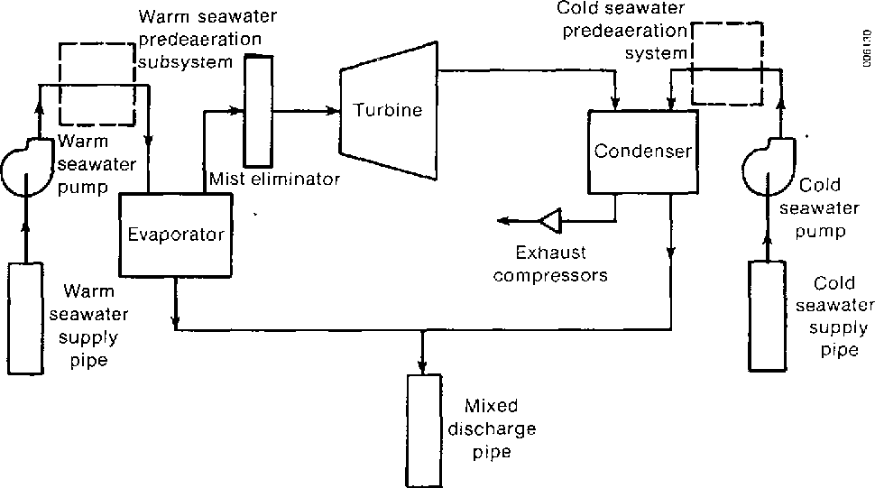

Slide 68
Ocean Thermal Energy (OTEC) is a real
candidate as one of the future sources of
energy.
Its environmental impact is negligible.
The mixing of deep and shallow
seawater brings up nutrients from the
seafloor.
The deep- water is rich in nitrates,
which can also be used in agriculture.

Slide 69
4. Forest Resources
Forests are natural, self-sustained biotic
community, predominantly characterized
by wooden, tall, dense tree and bulky
animals.
In areas where forests are destroyed, there are often floods after rainfalls, followed by drought.
Without the plants, the water cycle is compromised.
When there is a heavy rainfall, water will immediately flow to the lower ground and even cause floods because there are not enough plants to absorb the water and prevent all the water from flowing to the lower ground.

Slide 70
When there is little rainfall and too few plants, which give off moisture into the air, there will be drought.
Sometimes rivers will even dry up. If we personify the rivers, it is as though the rivers have died.
Therefore, protecting vegetation will bring far greater ecological benefits than building and maintaining dams.
Actually, if people can grow trees in the vast expanses of the barren mountains and shrubs in the plains, the forests will provide people with economic benefits and some of the proceeds can feed the costs of forest conservation programs.
Thus, by conserving nature, man and nature can together form a benevolent relationship. We can help protect the natural environment and in turn, the environment will nourish us.

Slide 71
.
Conservation of Forest-
Provision of more accurate and comprehensive estimates of quantity and quality of existing resources.
Improvement of existing forests by suitable silviculture and management practices by, (a) reservation and protection of more forests, (b) introduction of working plans.
Intensive forestry and plantation of fast-growing industrial woods on suitable deforested sites.
Adoption of modern techniques and development of the transport system to increase productivity.
Stimulation to suitable forest-based industries.
reducing consumption of forest and related products.

Slide 72
Deforestation- Deforestation is the permanent destruction of forests in order to make the land available for other uses.
Deforestation is considered to be one of the contributing factors to global climate change.
Trees absorb greenhouse gases and carbon emissions.
They produce oxygen and perpetuate the water cycle by releasing water vapor into the atmosphere.
Without trees, forest lands can quickly become barren land.

Slide 73
Causes of deforestation
Trees are used sold or exported as timber, wood or fuel. This is called logging.
. Forest lands are used for farming purpose (grazing fields for livestock or farming activities).
3. Making room for human settlement and urbanization like making space for shelter,
industries and roads.
4. Using forest land for mining.

Slide 74
CONSEQUENCES OF DEFORESTATION
The carbon cycle. Forests act as a major carbon store because carbon dioxide (CO2)is taken up from the atmosphere and used to produce the carbohydrates, fats, and proteins that make up the tree. When forests are cleared, and the trees are either burnt or rot, this carbon is released as CO2. This leads to an increase in the atmospheric CO2 concentration. CO2 is the major contributor to the greenhouse effect. It is estimated that deforestation contributes one-third of all CO2 releases caused by people.
The water cycle. Trees draw ground water up
through their roots and release it into the
atmosphere (transpiration). In Amazonia over half
of all the water circulating through the region’s
ecosystem remains within the plants

Slide 75
. With removal of part of the forest, the region
cannot hold as much water. The effect of this could
be a drier climate.
Soil erosion With the loss of a protective cover of vegetation more soil is lost.
Silting of water courses, lakes and dams This occurs as a result of soil erosion.
Extinction of species which depend on the forest for survival. Forests contain more than half of all species on our planet - as the habitat of these species is destroyed, so the number of species declines.
Desertification The causes of desertification are
complex, but deforestation is one of the
contributing factors

Slide 76
Chipko Movement- The Chipko movement or Chipko Andolan is a movement that practiced the Gandhian methods of non-violent resistance, through the act of hugging trees to protect them from being felled.
The modern Chipko movement started in the early 1970s in the Garwal Himalayas of Uttarakhand, then in Utter Pradesh with growing awareness towards rapid deforestation.
The landmark event in this struggle took place on March 26, 1974, when a group of peasant women in Reni village, Hemwalghati, in Uttarakhand, India, acted to prevent the cutting of trees and reclaim their traditional forest rights that were threatened by the contractors assigned by the state Forest Department.

Slide 77
Chipko Movement- The Chipko movement or Chipko Andolan …..
Their actions inspired hundreds of such actions at the grassroots level throughout the region. By the 1980s the movement had spread throughout India and led to the formulation of people-sensitive forest policies, which put a stop to the open felling of trees in regions as far reaching as Vindhyas and the western Ghats.
Today, it is seen as an inspiration and a precursor for Chipko movement of Garhwal. Its leader was Sunderlal Bahuguna.

Slide 78
EXTRA TOPICS
Food Resources
Human body needs food for various purposes. Food consumed by humans are of different types and a balanced diet is needed for all practical purposes, vitamins, proteins carbohydrates and minerals are primarily obtained from cereals, fruits, vegetables, pulses and spices, milk, butter, meat and eggs all of which obtained from different types of plants and animals.
These are our main food resource. A large number of items are consumed by human either in their natural states or after proper processing and cooking.
In general, a strong and healthy human consumes about 1.4 kg of food every day. Such a food serves as a source of energy and replacement of uses.

Slide 79
Problems of food security
Increasing cost of cultivation
Ecological degradation
Demand for water
Low productivity
Climate change
Rising population
World food problem
In world 13% population is
malnourished
2. In developed countries-<5%
3- In developing country-16%
4- In India-21%

Slide 80
Malnourishment and undernourishment
Not having enough to eat (undernourishment) and not having the right balance of nutrients (malnourishment) can both affect our skeletons. Some very specific conditions such as rickets and scurvy are caused by malnourishment – in these cases, not enough vitamin D or vitamin C respectively. But a poor diet in general during childhood can also affect how quickly children grow, and in severe cases can (temporarily) stop growth.
Malnutrition is poor nutrition because of an insufficient OR poorly balanced diet or faulty digestion or utilization of foods. This is mainly because deficiency/lack of particular component from our diet.
Undernutrition is also poor nutrition but ONLY because of INSUFFICIENT DIET, so, if one is undernourished, he would also be malnourished. but if one is malnourished, it doesn't mean he will be undernourished.

